Slide 1
Springing into Action
Spring is an open-source framework
Created by Rod Johnson in 2003
Enhances developers productivity.
Enforce best coding practices.

Slide 2
What is a framework?
Spring Framework is a Java platform that provides comprehensive infrastructure support for developing Java applications.
A framework is essentially a skeleton, a structure around which the fleshing out of your application occurs.
Frameworks tackle the common application problems.

Slide 3
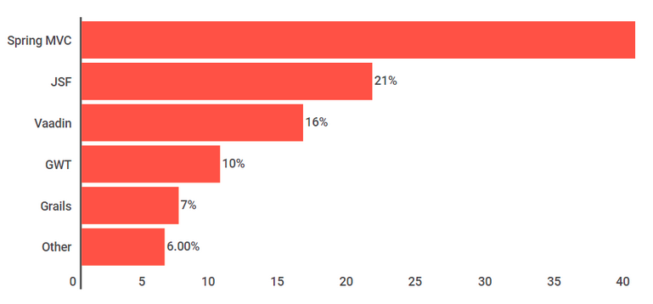
Best Java Frameworks

Slide 4
Spring Definition
Spring framework is an open source, light weight, loosely coupled, aspect oriented, dependency injection based Java Application Framework to develop various types of applications.
Every keyword in the definition is important

Slide 5
Advantages of Spring framework
1) Spring enables developers to develop enterprise-class applications using POJOs.
2) Spring is organized in a modular fashion.
3) Testing an application written with Spring is simple because environment-dependent code is moved into this framework.

Slide 6
4) Spring's web framework is a well-designed web MVC framework, which provides a great alternative to web frameworks.
5) Spring provides a convenient API to translate technology-specific exceptions
6) Lightweight IoC containers tend to be lightweight, especially when compared to EJB containers

Slide 7
How does Spring simplify Java development?
Lightweight and minimally invasive development with PoJo’s
Loose coupling through DI and interface orientation
Declarative programming through aspects and common conventions
Eliminating boilerplate code with aspects and templates.

Slide 8
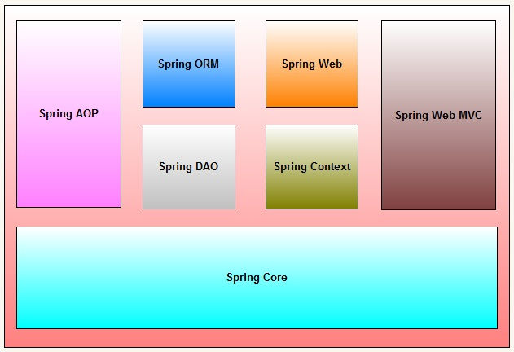
Spring Framework Architecture

Slide 9
What does Spring framework provide?
1) Application Context and Dependency Injection
2) Data Access (API’s)
3) Spring MVC

Slide 10
The 3 Key Things!
1) Dependency Injection
2) Maven
3) Spring MVC

Slide 11
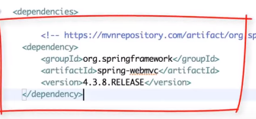
Maven – HeadsUp!
Build tool
By Apache
Third-Party libraries
Spring Dependencies – several libraries
1) Project (pom.xml)
2) GroupId
3) ArtifactId
4) Package

Slide 12
Injecting Dependencies
IoC Container or Dependency Injection Engine forms the Spring Core.
Dependency Injection or IoC makes life easy by
Making code significantly simpler
Easier to understand
Easier to test

Slide 13
Tightly coupled code is difficult to test, difficult to reuse and difficult to understand
A certain amount of coupling is necessary and acceptable.
With DI, objects are given their dependencies at creation time by some third party that coordinates each object in the system.

Slide 14
5 modes of DI in Spring
1) Setter injection
2) Constructor injection
3) Aware injection/Interface injection
4) Lookup method injection
5) Method Replacer/ Method Injection
Note: Most commonly used modes are 1 and 2

Slide 15
By Constructor
The <constructor-arg> subelement of <bean> is used for constructor injection.
<constructor-arg value="101" type="int"></constructor-arg>
By default when the Spring container loads the bean, it instantiates the bean with the default constructor. But you can also define a constructor argument in bean definition, using an argument constructor.

Slide 16
By setter method
The <property> sub-element of <bean> is used for setter injection.
<property name="id" value="101"></property>
Setter-based Dependency Injection is accomplished by the container calling setter methods on your beans after invoking a no-argument.

Slide 17
If the dependent object is assigned to main object by the IoC container through the setter method of the main class then its called By Setter Method.
If the dependent object is assigned to main object by the IoC container through the constructor/parameterised constructor of the main class then its called By Constructor.

Slide 18
Dependency Injection Example
In the application-context.xml, we have one line which initialize the bean and another to initialize the object of, let's say, MyClass
<bean id="myBean" class="org.mypackage.MyBean"/>
<bean id="myClass" class="org.mypackage.MyClass"/>
Then in MyClass
@Component
public class MyClass{
@AutoWire
MyBean myBean;

Slide 19
Dependency lookup
What is dependency lookup?
If resource of the application spends time to search and get dependent values from other resources of application, then it is called dependency lookup
Main component gets dependent component by searching for that component.
It contains that logic to search and get the dependent component.

Slide 20
Adv: Main/target component can get and use only required dependent component
DisAdv: Main/target component must have additional logic to search and gather dependent objects.
Resource has to spend time to search and get dependent values

Slide 21
Dependency Lookup Example
ApplicationContext applicationContext = new ClassPathXmlApplicationContext("/application-context.xml");
MyBean bean = applicationContext.getBean("myBean")
Here, the class itself is initializing the ApplicationContext through an XML, and it is searching in the context for the bean called myBean in the ApplicationContext

Slide 22
Underlying server, container, framework, runtime env dynamically creates MO and DO and also assigns MO to DO.
Finally returns the MO
Why is it called IoC?
Ex: Assigning material to student when he/she is registering for the course.
Ex: Java object creation through constructor

Slide 23
Note: Here, underlying server/container/framework dynamically pushes dependent objects to main/target objects.
Spring supports both dependency lookup and dependency injection.

Slide 24
Dependency Management
Service Class - Target class/Main class
DAO Class - Dependent class
Ex: Vehicle – Engine
WishMessageGenerator -> TargetClass
Date -> DependentClass

Slide 25
Containing the beans
In Spring-based application, objects live in the Spring container.
The container creates the objects, wires them together, configures them and manages their complete lifecycle.

Slide 26
IoC Container
The IoC container gets information from the XML file and works accordingly. The main tasks performed by IoC container are:
to instantiate the application class
to configure the object
to assemble the dependencies between the objects
There are two types of IoC containers. They are:
BeanFactory
ApplicationContext

Slide 27


Using BeanFactory
Using ApplicationContext

Slide 28
Limitations of OOP
Enabling/Disabling any secondary logic becomes complex
Business method logic becomes clumpsy.
Secondary logic is never reusable.

Slide 29
AOP (Aspect Oriented Programming)
Do not mix non-business logic with actual business logic in your classes.
Ex: Logging, transaction management, Caching etc are NBL
With OOP, primary and secondary logic is mixed-up.
But with AOP, there is a posibility to keep it seperate.

Slide 30
The primary and secondary logic can be mixed up @ runtime.
AOP is the recent modern style of prgamming
AOP tool (AOP enabled software) is used to generate one dynamic class @ runtime

Slide 31
Advantages of AOP
Secondary logic becomes re-uasable.
Enable/Disable secondary logic by manipulating xml or annotations without altering the code.
Business methods of service class has only primary logic. So code is clean and neat.

Slide 32
Data Access/ Integration Framework
1) Spring JDBC
2) Spring ORM
3) Spring OXM
4) Spring JMS
5) Spring Transaction Management

Slide 33
Creating spring application in Eclipse IDE
Create the java project
Add spring jar files
Create the class
Create the xml file to provide the values
Create the test class

Slide 34
A bean’s life w.r.t Spring
1. Spring instantiates the bean.
2. Spring injects values and bean references into the bean’s properties.
3. If the bean implements BeanNameAware, Spring passes the bean’s ID to the setBeanName() method.
4. If the bean implements BeanFactoryAware, spring calls the setBeanFactory() method, passing in the bean factory itself.

Slide 35
5. If the bean implements ApplicationContextAware, Spring calls the setApplicationContext() method, passing in a reference to the enclosing application context.
6. If the bean implements BeanPastProcessor interface, Spring calls its postProcessBeforeInitialization() method.

Slide 36
7. If the bean implements InitializingBean interface, Spring calls its afterPropertiesSet() method.
8. If the bean implements BeanPostProcessor, Spring calls its postProcessAfterInitialization()
9. Bean is ready to use by the application.
10. If the bean implements DisposableBean interface, Spring calls its destroy() method.

Slide 37
Spring Bean
The objects that form the backbone of your application and that are managed by the Spring IoC container are called beans.
A bean is an object that is instantiated, assembled, and otherwise managed by a Spring IoC container.

Slide 38
Wiring Beans
The act of creating associations between application objects is the essence of DI and is commonly referred to as Wiring.
There are three primary wiring mechanisms
1) Explicit configuration in XML
2) Explicit configuration in Java
3) Implicit bean discovery and automatic wiring.

Slide 39
Its developers responsibility to tell Spring which beans to create and how to wire them together.
Which one to chose when?
Automatic configuration is always a better choice.

Slide 40
Automatically wiring beans
Spring does automatic wiring from two perspectives-
1) Component Scanning – Spring automatically discovers beans to be created in the application context
2) Autowiring – Spring automatically satisfies bean dependencies.

Slide 41
Autowiring modes
Sr.No | Mode and Description
1 | no This is default setting which means no autowiring and you should use explicit bean reference for wiring. You have nothing to do special for this wiring.
2 | byName Autowiring by property name. Spring container looks at the properties of the beans on which autowire attribute is set to byName in the XML configuration file. It then tries to match and wire its properties with the beans defined by the same names in the configuration file.
3 | byType Autowiring by property datatype. Spring container looks at the properties of the beans on which autowire attribute is set to byType in the XML configuration file.

Slide 42
Autowiring modes
 | It then tries to match and wire a property if its type matches with exactly one of the beans name in configuration file. If more than one such beans exists, a fatal exception is thrown.
4 | constructor Similar to byType, but type applies to constructor arguments. If there is not exactly one bean of the constructor argument type in the container, a fatal error is raised.
5 | autodetect Spring first tries to wire using autowire by constructor, if it does not work, Spring tries to autowire by byType.

Slide 43
Limitations with autowiring
Autowiring works best when it is used consistently across a project. If autowiring is not used in general, it might be confusing for developers to use it to wire only one or two bean definitions.
Overriding possibility -You can still specify dependencies using <constructor-arg> and <property> settings which will always override autowiring.

Slide 44
Primitive data types - You cannot autowire so-called simple properties such as primitives, Strings, and Classes.
Confusing nature - Autowiring is less exact than explicit wiring, so if possible prefer using explict wiring.

Slide 45
Annotation based Configuration
Starting from Spring 2.5 it became possible to configure the dependency injection using annotations.
Annotation injection is performed before XML injection.
Annotation wiring is not turned on in the Spring container by default. So, before we can use annotation-based wiring, we will need to enable it in our Spring configuration file.

Slide 46
<?xml version = "1.0" encoding = "UTF-8"?>
<beans xmlns = "http://www.springframework.org/schema/beans"
xmlns:xsi = "http://www.w3.org/2001/XMLSchema-instance"
xmlns:context = "http://www.springframework.org/schema/context"
xsi:schemaLocation = "http://www.springframework.org/schema/beans
http://www.springframework.org/schema/beans/spring-beans-3.0.xsd
http://www.springframework.org/schema/context
http://www.springframework.org/schema/context/spring-context-3.0.xsd">
<context:annotation-config/>
<!-- bean definitions go here -->
</beans>

Slide 47
Sl No. | Annotation and Description
1 | @Required The @Required annotation applies to bean property setter methods.
2 | @Autowired The @Autowired annotation can apply to bean property setter methods, non-setter methods, constructor and properties.
3 | @Qualifier The @Qualifier annotation along with @Autowired can be used to remove the confusion by specifiying which exact bean will be wired.
4 | JSR-250 Annotations Spring supports JSR-250 based annotations which include @Resource, @PostConstruct and @PreDestroy annotations.

Slide 48
Explicit configuration in Java
Java-based configuration option enables you to write most of your Spring configuration without XML but with the help of few Java-based annotations
@Configuration
@Bean
@Import

Slide 49
@Configuration is a class-level annotation indicating that an object is a source of bean definitions.
@Configuration classes declare beans through public @Bean annotated methods.
Calls to @Bean methods on @Configuration classes can also be used to define inter-bean dependencies.

Slide 50
@Bean is a method-level annotation and a direct analog of the XML <bean/> element.
The annotation supports some of the attributes offered by <bean/>, such as: * init-method * destroy-method * autowiring * name.

Slide 51
Example1
@Configuration
public class AppConfig {
@Bean
public TransferServiceImpl transferService() {
return new TransferServiceImpl();
}
}

Slide 52
Example2 – Inter-bean dependencies
@Configuration
public class AppConfig {
@Bean
public BeanOne beanOne() {
return new BeanOne(beanTwo());
}
@Bean
public BeanTwo beanTwo() {
return new BeanTwo();
}

Slide 53
Spring Web MVC
Spring Web MVC is the original web framework built on the Servlet API.
The Spring Web MVC framework provides Model-View-Controller (MVC) architecture and ready components that can be used to develop flexible and loosely coupled web applications.

Slide 54
MVC
The Model encapsulates the application data and in general they will consist of POJO.
The View is responsible for rendering the model data and in general it generates HTML output that the client's browser can interpret.
The Controller is responsible for processing user requests and building an appropriate model and passes it to the view for rendering.

Slide 55
Spring Web MVC
Dispatcher Servlet
Handler Mappings
Controllers
View Resolvers

Slide 56
Spring Web MVC
A front Controller is a common web application pattern where a single servlet delegates the responsibility for a request to other components of an application to perform actual processing.
A controller is a Spring component that actually processes the request.

Slide 57
Why Spring Web MVC?
Easy to work with.
Flexible
Separation of concern (Modules)

Slide 58
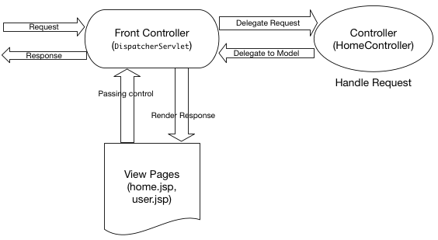
Spring MVC at a higher level

Slide 59
Explanation
After receiving an HTTP request, DispatcherServlet consults the HandlerMapping to call the appropriate Controller.
The Controller takes the request and calls the appropriate service methods based on used GET or POST method. The service method will set model data based on defined business logic and returns view name to the DispatcherServlet.
The DispatcherServlet will take help from ViewResolver to pickup the defined view for the request.

Slide 60
Explanation
Once view is finalized, The DispatcherServlet passes the model data to the view which is finally rendered on the browser.
NOTE: HandlerMapping, Controller, and ViewResolver are parts of WebApplicationContext

Slide 61
A Spring MVC example in Eclipse
DispatcherServlet is the front controller class to take all requests and start processing them. We have to configure it in web.xml file. It’s job is to pass request to appropriate controller class and send the response back when view pages and have rendered the response page.
HomeController.java will be the single controller class in our spring mvc example application.
home.jsp, user.jsp are the view pages in our spring mvc hello world example application.

Slide 62
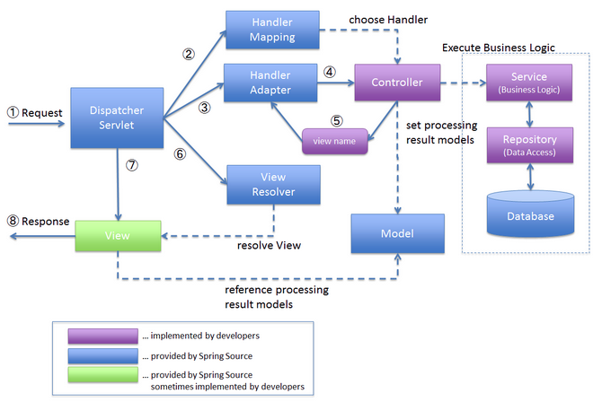

Slide 63
1. DispatcherServlet receives the request.
2. DispatcherServlet dispatches the task of selecting an appropriate controller to HandlerMapping. HandlerMapping selects the controller which is mapped to the incoming request URL and returns the (selected Handler) and Controller to DispatcherServlet.
3. DispatcherServlet dispatches the task of executing of business logic of Controller to HandlerAdapter.
4. HandlerAdapter calls the business logic process of Controller.

Slide 64
5. Controller executes the business logic, sets the processing result in Model and returns the logical name of view to HandlerAdapter.
6. DispatcherServlet dispatches the task of resolving the View corresponding to the View name to ViewResolver. ViewResolver returns the View mapped to View name.
7. DispatcherServlet dispatches the rendering process to returned View.
8. View renders Model data and returns the response.

Slide 65
web.xml
<?xml version="1.0" encoding="UTF-8"?>
<web-app xmlns:xsi="” ...................>
<display-name>spring-mvc-example</display-name>
<!-- Add Spring MVC DispatcherServlet as front controller -->
<servlet>
<servlet-name>spring</servlet-name>
<servlet-class> org.springframework.web.servlet.DispatcherServlet
</servlet-class>
<init-param>
<param-name>contextConfigLocation</param-name>
<param-value>/WEB-INF/spring-servlet.xml</param-value>
</init-param>
<load-on-startup>1</load-on-startup>
</servlet>
<servlet-mapping>
<servlet-name>spring</servlet-name>
<url-pattern>/</url-pattern>
</servlet-mapping>
</web-app>

Slide 66
spring-servlet.xml
<?xml version="1.0" encoding="UTF-8"?>
<beans:beans xmlns="....." ....>
<annotation-driven />
<context:component-scan base-package="com.journaldev.spring.*" />
<beans:beanclass="org.springframework.web.servlet.view.InternalResourceViewResolver">
<beans:property name="prefix" value="/WEB-INF/views/" />
<beans:property name="suffix" value=".jsp" />
</beans:bean>
</beans:beans>

Slide 67
The [servlet-name]-servlet.xml file will be used to create the beans defined, overriding the definitions of any beans defined with the same name in the global scope.
The <context:component-scan...> tag will be use to activate Spring MVC annotation scanning capability which allows to make use of annotations like @Controller and @RequestMapping etc.
The InternalResourceViewResolver will have rules defined to resolve the view names. As per the above defined rule, a logical view named hello is delegated to a view implementation located at /WEB-INF/views/.

Slide 68
Writing a basic Controller
In Spring MVC Controllers are just classes with methods that are annotated with @RequestMapping to declare the kind of mappings they will handle.
@Controller is a stereotype annotation based on @Component annotation.
Its purpose is entirely for the benefit of Component Scanning.

Slide 69
Example - HomeController
@Controller - indicates that a particular class serves the role of a controller.
@RequestMapping - used to map a URL to either an entire class or a particular handler method.
@RequestMapping(value = "/", method = RequestMethod.GET) - indicates that all handling methods on this controller are relative to the / path and controller's default service method to handle HTTP GET request is used.

Slide 70
An example of extremely simple controller
package web;
import static org.springframework.web.bind.annotation.RequestMethod.*;
import org.springframework.stereotype.Controller;
import org.springframework.web.bind.annotation.RequestMapping;
import org.springframework.web.bind.annotation.RequestMethod;
@Controller
public class HomeController {
@RequestMapping(value=”/”, method=”GET”)
public String home() {
return “home”;
}
}
Declared to be a controller
Handle GET requests for /
View name is home

Slide 71
Test class for HomeController
package web.test;
import static org.junit.Assert.assertEquals;
import org.junit.Test;
import web.HomeController;
public class HomeControllerTest {
public void testHomePage() throws Exception {
HomeController controller = new HomeController();
assertEquals(“home”, controller.home());
}
}

Slide 72
Defining class-level Request handling
Split-up @RequestMapping by placing the path-mapping portion of it at the class-level.
@Controller
@RequestMapping(“/”)
public class HomeController {
@RequestMapping(method=”GET”)
public String home() {
return “home”;
}
}
Map controller to /
Handle GET requests
View name is home

Slide 73
Form Processing
The <form:form> tag plays an important role in Spring MVC.
To display the input form, we are going to use <form:form> tag of spring framework.
It’s very similar to the regular HTLM <form> tag but the commandName/modelAttribute attribute is the key which specifies name of the model class

Slide 74
Ex: <form:form action="register" method="post" commandName="userForm">
The important attribute of each tag is path - which specifies name of a property of the model class

Slide 75
An example
<form:label path = "name">Name</form:label>
<form:input path = "name" />
<form:label path = "age">Age</form:label>
<form:input path = "age" />
<form:label path = "id">id</form:label>
<form:input path = "id" />
<input type = "submit" value = "Submit"/>

